Slide 1


Data Protection & Privacy

Slide 2

Checking anonimity of transaction databases through (h,k,p)-Coherence
Flavio Bava
Edoardo Oldrini
Francesco Ciarlo

Slide 3
HKP COHERENCE

Slide 4
The Issue
By Paper (Example_1):
AOL has recently made available a query logs database to the public, primarily for research purposes. Nevertheless, through the analysis of search items, the user identified as No. 4417749 was successfully linked to Thelma Arnold, a 62-year-old widow residing in Lilburn. This exemple show that even when queries lack of specific address or name information, it remains possible to re-identify a user, based on distincitve combinations of query terms.

Slide 5
A possible solution
HKP-Coherence
We define a database property where, for a given combination of public items, it ensures that an attacker with a limited and known power (up to “p”) cannot easily link individuals to transactions or private items.
To do so, we require a certain number of transaction containing a combination (β-cohort) and restrinct the presence of common private items in transactions.

Slide 6
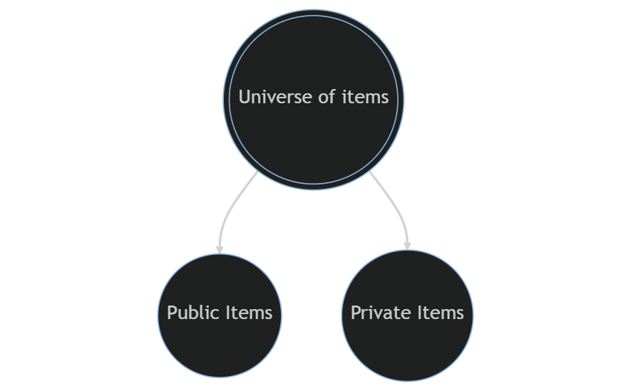
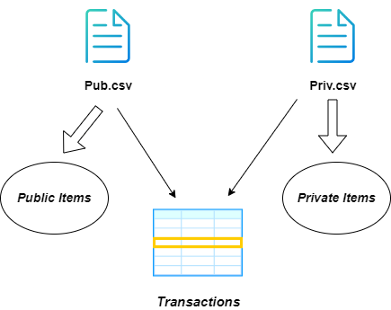
The basic idea

Slide 7
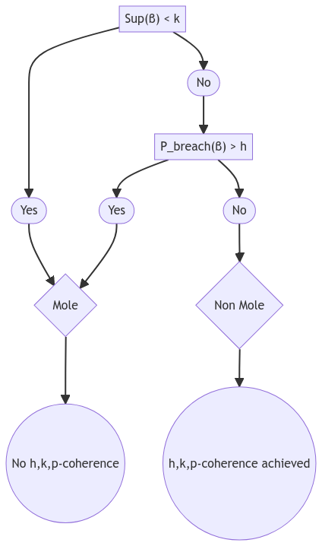
The concept of MOLE
β-cohort refers to the set of transactions that contain β as a subset.
Sup(β), the support of β, denotes the number of transactions in β-cohort.
Sup(β∪{e}) is the probability that a transaction contains e, given that it contains β.
Pbreach(β), called the breach probability of β, is the maximum P(β→e) for any private item e, where P(β→e) = Sup(β∪{e})/Sup(β).

Slide 8
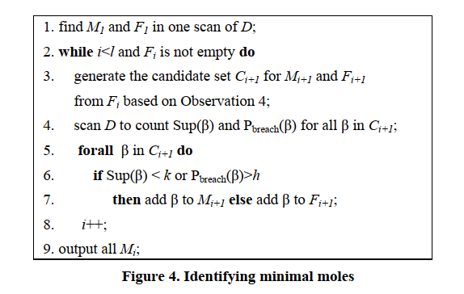
Identifying minimal moles
Our implementation
A loop that iteratively find moles of increasing sizes up to a limit (p) in which we:
Obtain size-1 moles.
Remove size-1 moles from consideration for further iterations.
Explore larger moles' combinations.
Apply conditions to find minimal moles
Update MM dictionary to count elements in minimal moles.
Return:
The dictionary M, holding minimal moles of different sizes.
The dictionary F, with non-moles founded during iterations.
The dictionary MM, tracking element occurrences in minimal moles.

Slide 9
eliminating minimal moles
Four different heuristics:
Let’s define:
MM as the number of times an element appears in a minimal mole
IL as the information lost by eliminating it
Paper approach:
Remove each time the element with the highest MM/IL ratio and repeat this operation until the dataset is anonymized.
Pro: optimal solution
Cons: high computational burden
Half:
Remove each time half of the public elements with the highest MM/IL ratio and continue this process until complete anonymization is achieved.
Pros: High execution speed
Cons: Overshooting information loss
Top X:
Remove each time the top X public elements with the highest MM/IL ratio and continue this operation until the dataset is fully anonymized.
Execution speed and overshooting information loss can be adjusted at will.
Suppress all:
Remove all the public items contained in a minimal mole.
This operation anonymizes the dataset in a single iteration, making the execution speed dependent solely on the number of minimal moles.

Slide 10
OUR CODE

Slide 11
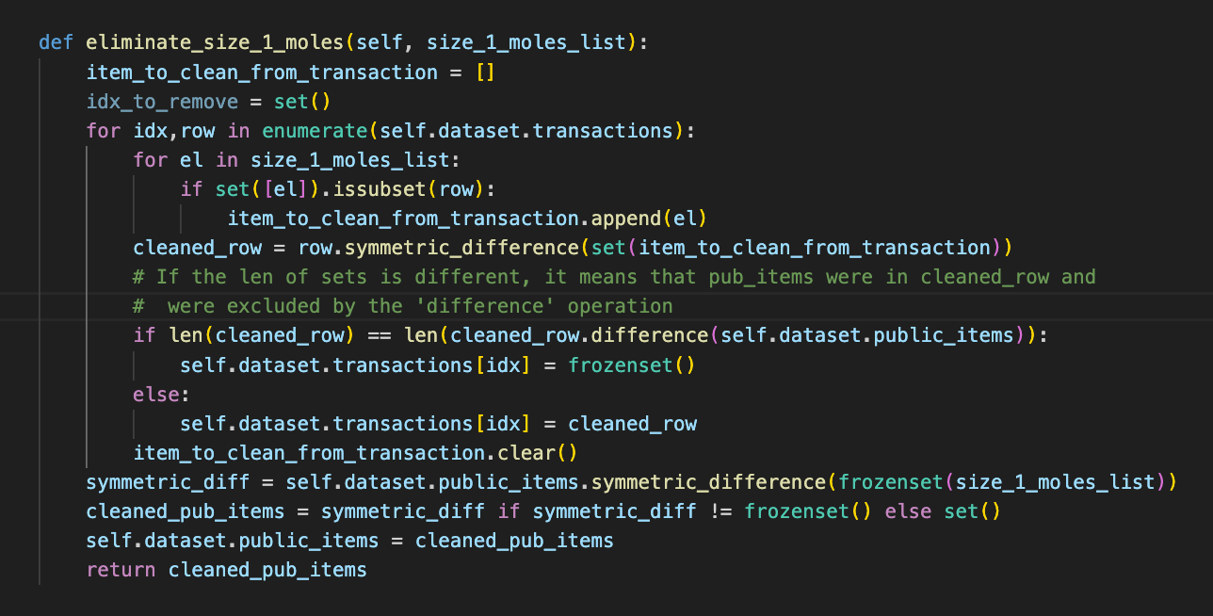
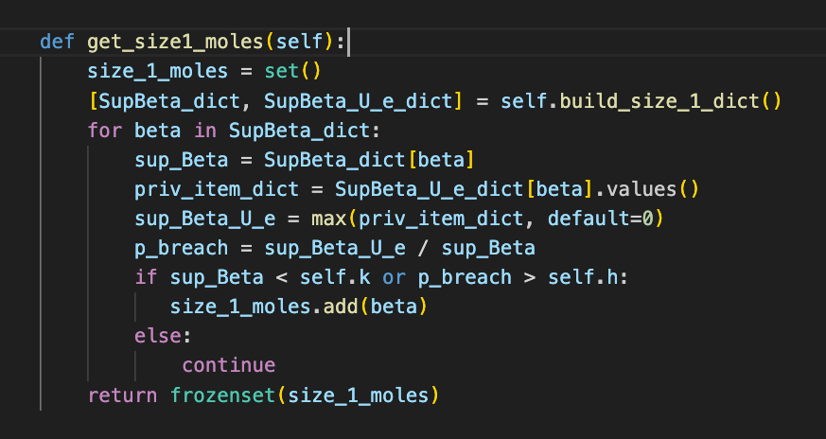
Size one moles search and elimination
We employ two functions: one to identify size-1 moles based on specified conditions in the paper (either Sup(β)<k or Pbreach(β)>h), and the other to eliminate them, updating public items and transactions accordingly.

Slide 12
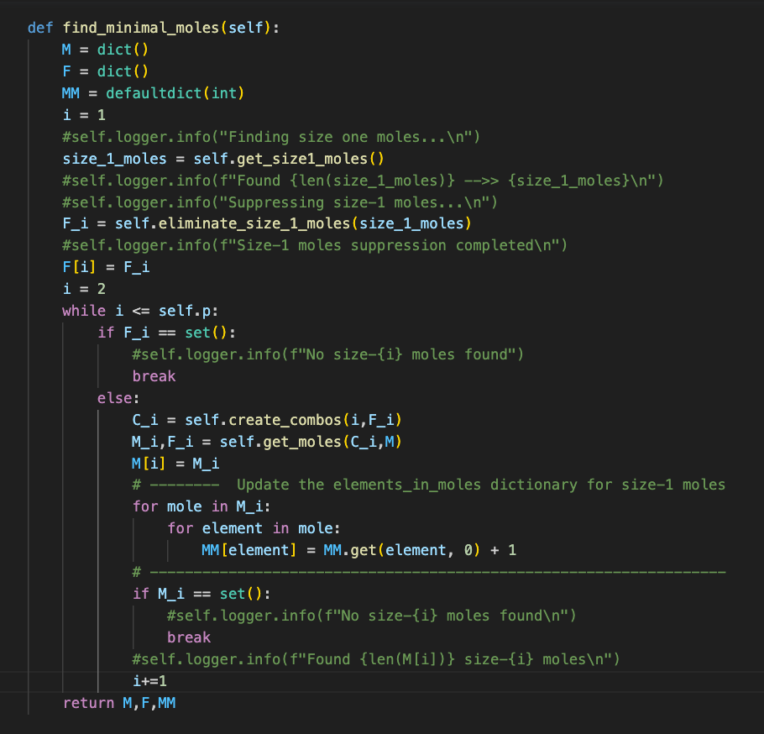
Find minimal moles
"This function is invoked after 'eliminate_size1_moles' to compute all the minimal moles. It returns three essential elements:
MM: A dictionary where the keys represent the i-th public item within the list of minimal moles, and values signify the count of minimal moles containing that specific public item.
F: Initially holds the size_1 moles, but progressively accumulates all the size-i non-moles.
M: Represents all the minimal moles within the dataset."

Slide 13
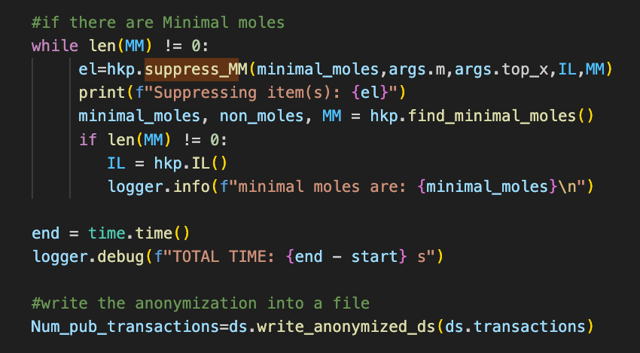
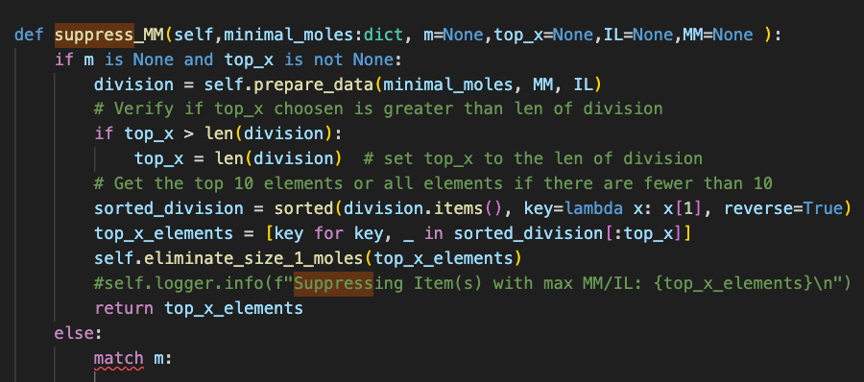
Suppress minimal moles
The 'Suppress MM' function computes the MM/IL ratio and arranges the elements in descending order of this ratio. It then invokes the 'm' method to suppress the moles. In the main program, this function is iteratively called until no more minimal moles remain in the dataset, and corresponding logs and prints are generated.
Main.py
Hkp.class

Slide 14
Suppress minimal moles
HKP.class
The 'Suppress MM' function computes the MM/IL ratio and arranges the elements in descending order of this ratio. It then invokes the 'm' method to suppress the moles.
MAIN.py
In the main program, this function is iteratively called until no more minimal moles remain in the dataset, and corresponding logs and prints are generated.

Slide 15
PERFORMANCES

Slide 16
Performance analysis summary
Dataset
The dataset used for performance analysis consists of 1000 rows, with 6 columns for public elements and 24 columns for private elements.
Interest
Our objective was to assess the efficiency by varying h, k and p, using four different approaches for minimal moles elimination:
One at a time
Half of them
All of them
Only the first 10-15-20-25
Method
We employed a Python notebook to execute the script with diverse heuristic and of h, k and p values, saving the performance data. Subsequently, we used these results to generate statistics and visual representations

Slide 17
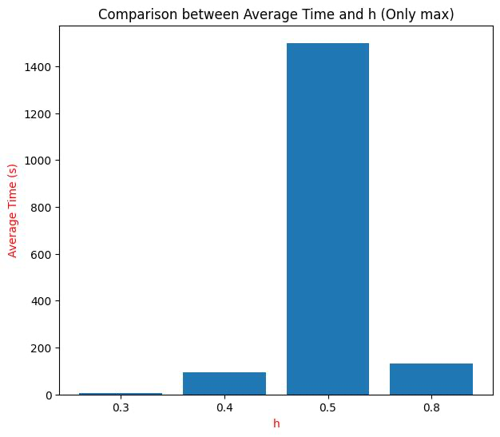
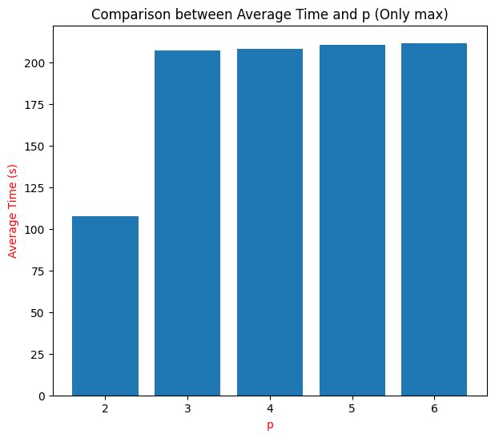
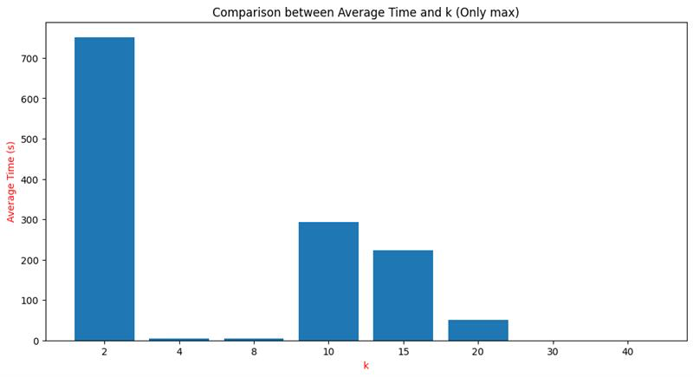
paper approach (Onlymax)

Slide 18
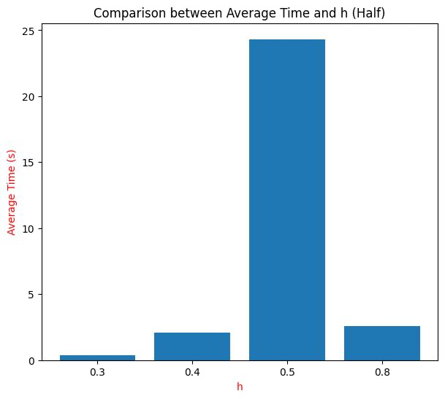
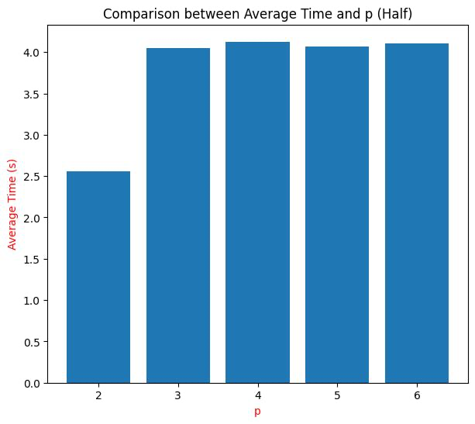
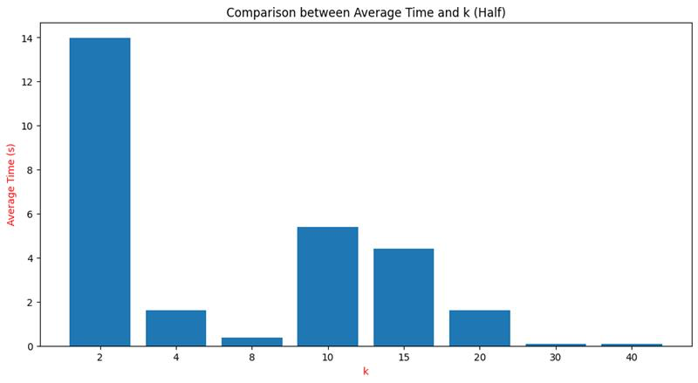
Heuristic i ( half)

Slide 19
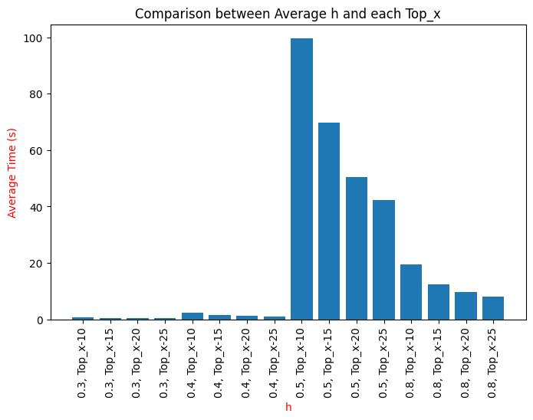
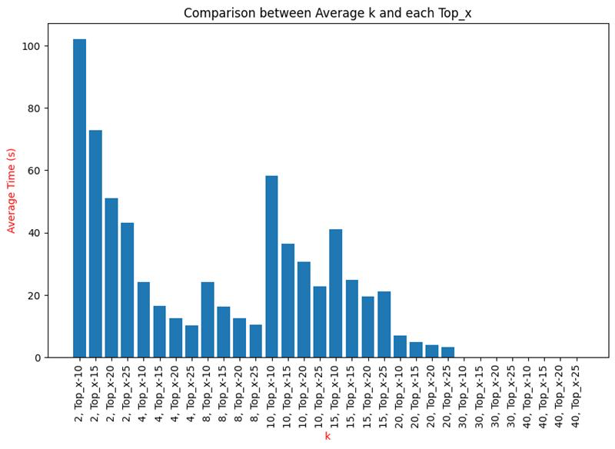
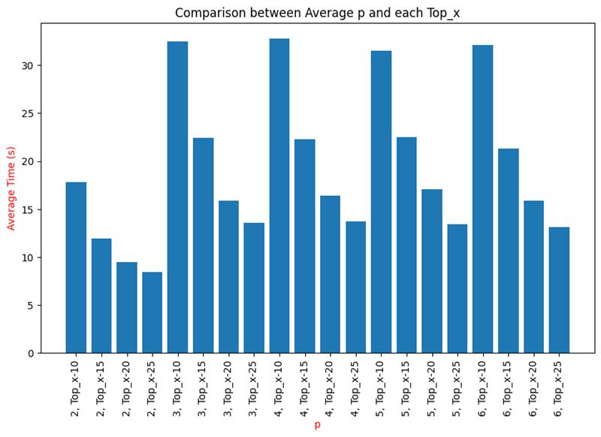
Heuristic ii (TOP X)

Slide 20
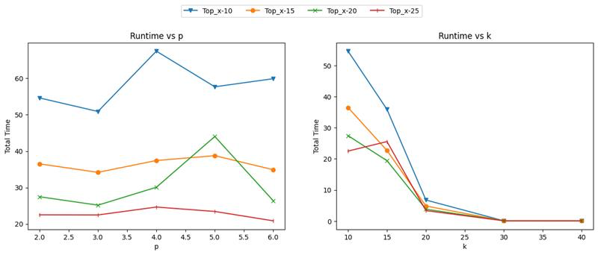
Heuristic ii (TOP X) continue

Slide 21
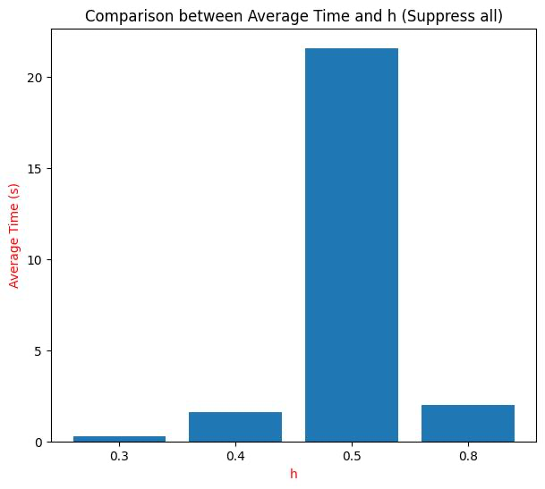
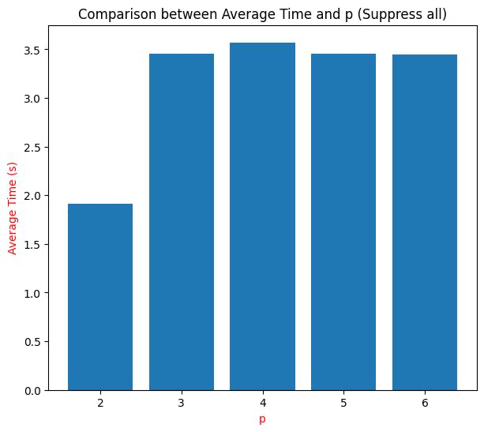
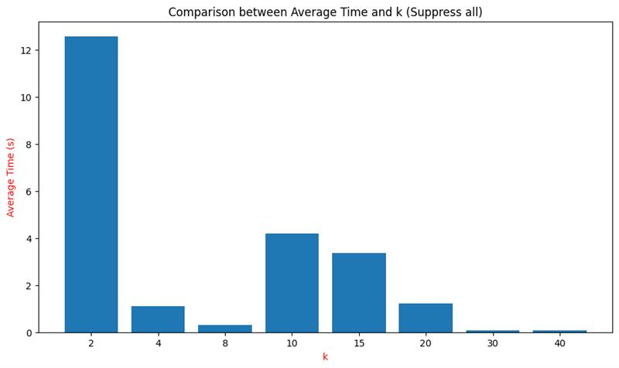
heuristic iii (suppress all)

Slide 22
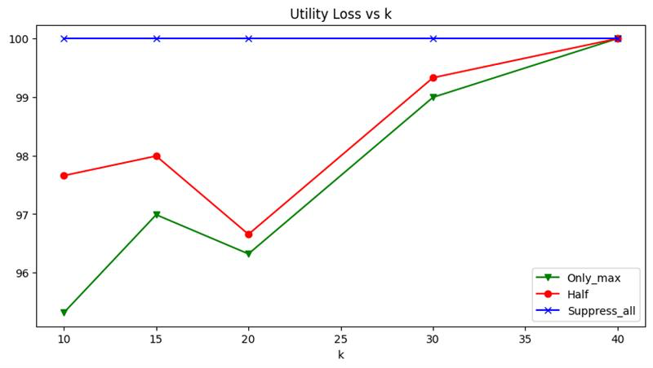
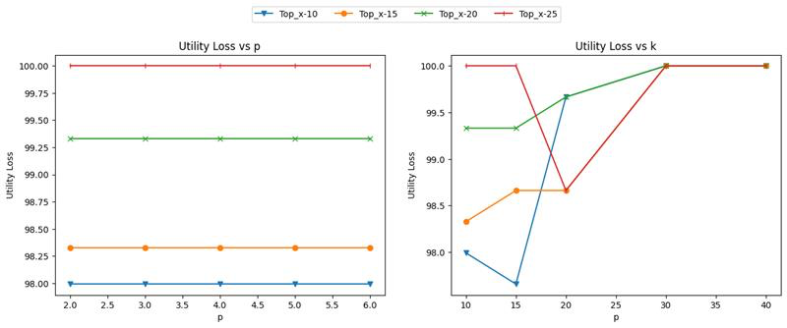
Utility loss
Only_max, Half, Suppress_all
Top X

Slide 23
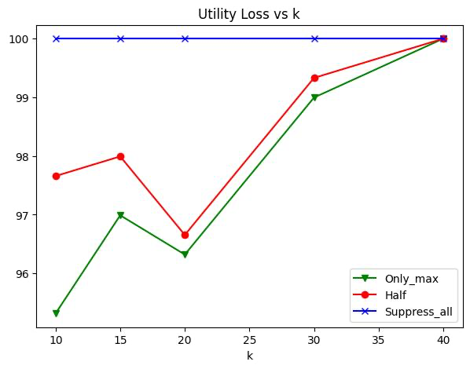
Utility loss
Only_max, Half, Suppress_all
Top X

Slide 24

thanks

